Slide 1

Flinkit
Flinlit
Flinlit
Flinlit
By: Tamanna goswami

Slide 2
Objectives
Flinkit
To simplify and streamline digital collaboration among team members or users.
To provide a user-friendly platform for managing tasks, projects, or content.
To enhance productivity through intuitive design and automation features.
To support real-time communication and file sharing within a secure environment.
To integrate seamlessly with existing tools and platforms used by target audiences.
To offer customizable workflows tailored to diverse business or educational needs.
To ensure data privacy, security, and compliance with relevant regulations.
To gather user feedback for continuous improvement and innovation.
Flinkit
Flinkit

Slide 3
Problem Statement
Flinkit
Problem Statement (Compact & Clear):
Modern users often struggle with fragmented digital tools that hinder productivity and collaboration.
Communication gaps, disorganized workflows, and a lack of integration between platforms make it difficult to
manage tasks efficiently. Flinkit addresses these challenges by offering a unified, easy-to-use solution designed to streamline collaboration, enhance task management, and simplify digital communication.
Let me know if you'd like it tailored for a specific use case like education, marketing, or remote work.
Flinkit
Flinkit

Slide 4
Approach
"Flinkit adopts a user-centered approach by combining intuitive design with essential collaboration features such as real-time communication, task tracking, and file sharing. The platform is built using scalable cloud technology, ensuring accessibility across devices and seamless integration with popular third-party tools. Continuous user feedback is incorporated to refine features and improve the overall experience."
Keyword Research & Optimization
1. Keyword Research:
Identify high-traffic, relevant keywords such as “team collaboration tool,” “project management app,” “digital workspace,” and “real-time task manager.”
Use tools like Google Keyword Planner, SEMrush, or Ubersuggest to find keywords with high search volume and low to medium competition.
Analyze competitor keywords and identify long-tail variations like “best tool for remote team collaboration” or “easy project manager for students.”
2. Keyword Optimization:
Integrate primary and secondary keywords naturally into website content, meta titles, meta descriptions, headers (H1, H2), and alt text.
Create keyword-rich blog content targeting specific use cases or problems (e.g., “How to manage remote teams effectively”).
Monitor keyword performance using tools like Google Search Console and update content regularly to maintain or improve rankings.
2.On-Page SEO Optimization
Product Page Optimization
Category & Landing Pages
Flinkit
Flinkit
Flinkit

Slide 5
2.On page SEO Optimization
Title tags
Meta discriptions
Header tags
Keywords palcement
3. Content Strategy & Blogging
Content Planning Blueprint
Blogging for Growth
Strategic Content Creation
SEO Blogging Tips
Audience Engagement Tactics
4. Technical SEO
Site Speed Optimization
Mobile Optimization
Structured Data
Structured Data
Flinkit
Flinkit
Flinkit

Slide 6
5. Link Building & Backlink Strategy
Backlink Strategy
Link Building
Authority Links
6. Local SEO Strategy
Local Listings
Geo Targeting
Map Optimization
Citation Building
Finkit
Flinkit
Flinkit

Slide 7
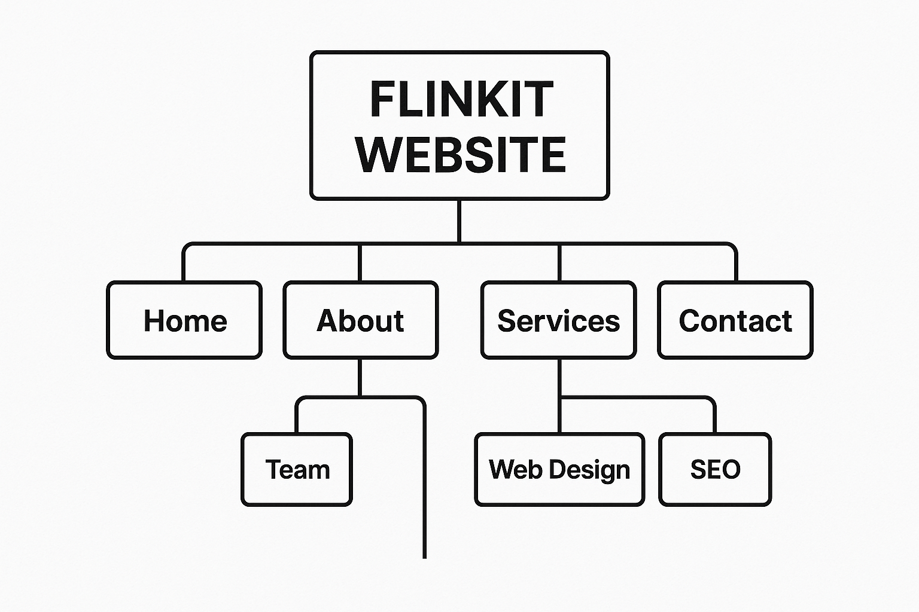
Website Structure
Flinkit
Flinkit
Flinkit

Slide 8
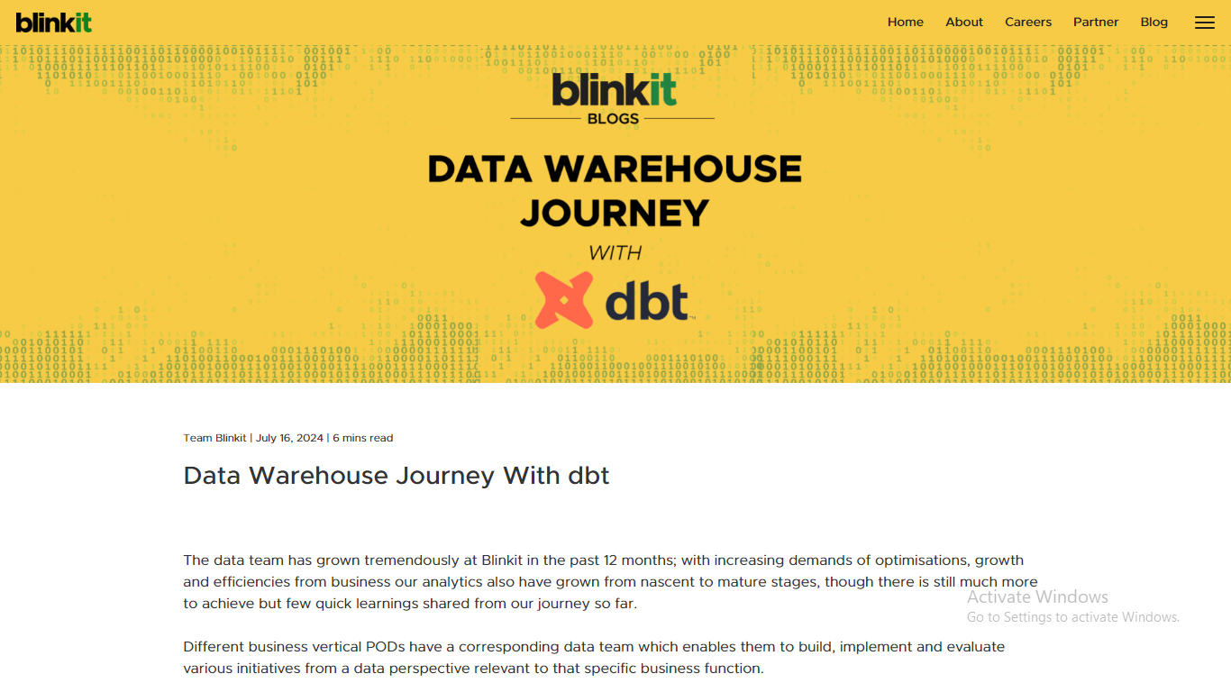
Blog page
Flinkit
Flinkit
Flinkit

Slide 9
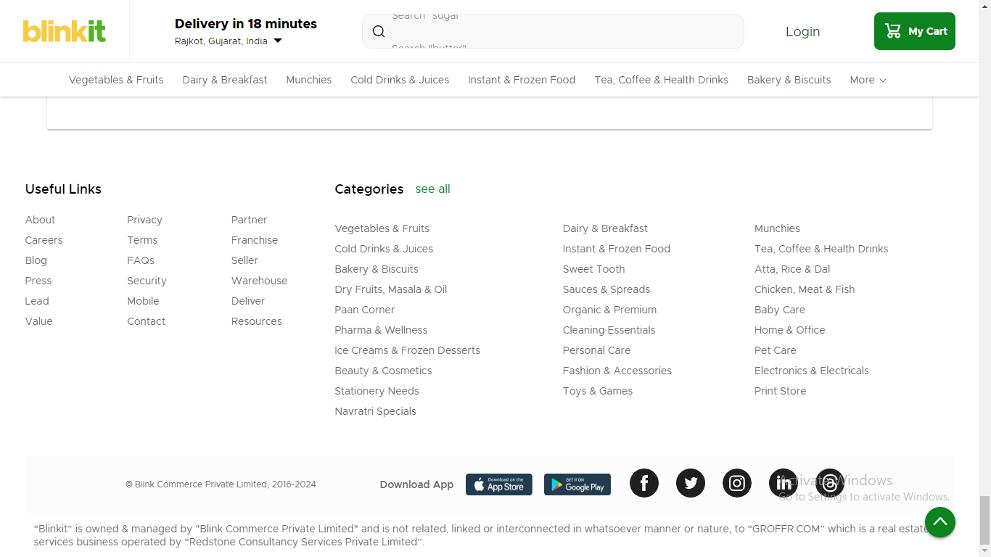
Categories page
Flinkit
Flinkit
Flinkit

Slide 10
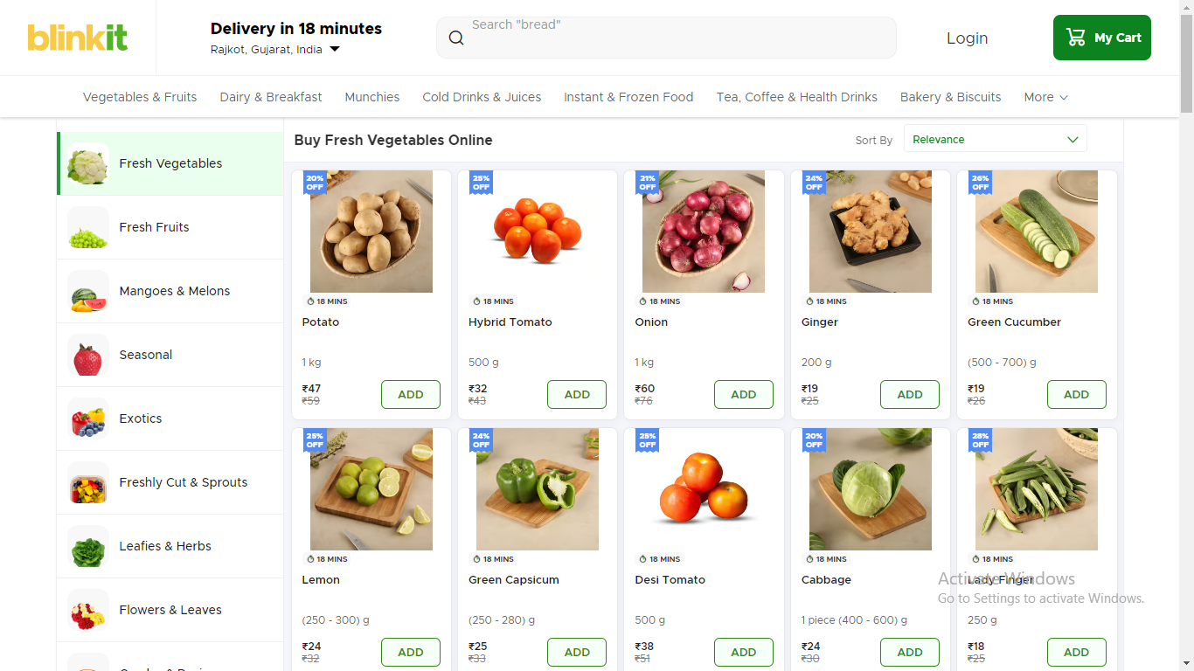
Sub Categories page
Flinkit
Flinkit
Flinkit

Slide 11
Content structure
Flinkit is a fast-commerce platform that focuses on delivering groceries and essentials to consumers in a quick and efficient manner. The content structure of Flinkit can be broken down into several key components, which are designed to provide a smooth user experience for browsing and ordering products. Here's a breakdown of its typical content structure Customer Support
📱 Phone: 1800-XXX-XXXX
💬 Live Chat: Available in-app and on website
📧 Email: support@blinkit.com
Corporate Office
🏢 BlinkIt HQ, [Address]
🕒 Hours: Mon–Fri, 9 AM – 6 PM
Social Media📘 Facebook: @blinkit
🐦 Twitter: @blinkitindia📸
Instagram: @blinkit.in :
Flinkit
Flinkit
Flinkit

Slide 12
Competitive Analysis
Flinkit
In the fast-commerce and online grocery delivery sector, Flinkit competes with several well-established and emerging brands. Major competitors include:
BigBasket
Amazon Pantry
JioMart
Dunzo
Zepto
Flipkart Supermart
Flinkit
Flinkit

Slide 13
Keyword Research
Here’s a breakdown of how to approach keyword research for Flinkit, including primary, secondary, long-tail keywords, and focus on local SEO:
Keyword Categories for Flinkit
Primary Keywords (High-Volume, General)
Brand
Service
Product
Content
Features
Comparison
Audience
Flinkit
Flinkit
Flinkit

Slide 14
Secondary Keywords (Product-Specific, Related)
Fresh produce delivery
Dairy delivery
Snacks delivery
Organic groceries online
Fresh fruits delivery
Buy vegetables online
Home essentials delivery
Healthy food delivery
Personal care products delivery
Frozen foods delivery
Flinkit
Flinkit
Flinkit

Slide 15
On-Page elements
Creating on-page SEO elements for Flinkit involves optimizing various key elements on the website or app to improve its visibility in search engine results, increase user engagement, and drive conversions
1. Meta Tags (Title & Description)
2. URL Structure
3. Headings (H1, H2, H3, etc.)
4. Content Optimization
5. Image Optimization
6. Internal Linking
7. Call to Action (CTA)
8. Mobile Optimization
9. Schema Markup (Structured Data)
Flinkit
Flinkit
Flinkit

Slide 16
Flinkit: Leveraging Keywords and On-Page Elements for SEO Success
Flinkit has become a leading name in India's fast-growing online grocery delivery space. As the competition in the e-commerce market intensifies, it’s crucial for Flinkit to maintain a strong digital presence. A key part of this is optimizing its website using targeted keywords and on-page elements to improve search engine rankings and enhance user experience.
To succeed in SEO, Flinkit must identify and target the right keywords. Primary keywords like "online grocery delivery," "same-day grocery delivery," and "grocery store delivery" help attract customers looking for quick and reliable grocery services. Secondary keywords related to specific product categories, such as "fresh produce delivery," "organic groceries," and "snacks delivery," allow Flinkit to target niche customer needs.
Flinkit
Flinkit
Flinkit

Slide 17
Optimizing On-Page Elements
For Flinkit to rank higher on search engines, optimizing on-page elements is crucial. Here’s how Flinkit can effectively use these SEO components:
Title Tags: Flinkit’s title tags should contain relevant keywords, such as “Order Fresh Groceries Online – Quick Delivery in Delhi | Flinkit.” Clear and keyword-focused titles improve click-through rates and search rankings.
Meta Descriptions: These descriptions summarize the page’s content and should include key phrases. A compelling example could be, “Order fresh groceries online from Flinkit and get fast, same-day delivery in Delhi.”
Headings (H1, H2): The main heading (H1) should be informative and contain the target keyword, like “Order Fresh Groceries with Flinkit – Fast Delivery in 30 Minutes.” Subheadings (H2) should further elaborate on specific offerings, such as “Same-Day Delivery” or “Fresh Produce & Organic Groceries.”
Content: The content must incorporate primary and secondary keywords naturally to ensure that both search engines and users can easily understand the offerings. Content should also be engaging, answering customer questions and providing value.
Images & Alt Text: Optimizing images with descriptive alt text, such as “fresh vegetables delivery Flinkit,” helps search engines understand the context of images and improves visibility in image search
Flinkit
Flinkit
Flinkit

Slide 18
Thank You
Flinkit
Flinkit
Flinkit

